Slide 1

slide
require
be stuck in
insistent
come upon
stick around
spirit
pull off
clarify
typical
glance
manage to do
claim
miss out
attempt
forgive
remove
urge

Slide 2
Language Points

Slide 3
（关系）陷于困境，濒临崩溃
Friendship on the rocks: Please advise!

Slide 4
Para. 1
Amy
My best friend and I have been close for eight years. When I was an awkward primary school student, she was the popular girl who was willing to make friends with me. Since then, a close friendship has grown between us and she’s been almost like a sister to me. Whether we’re walking to school, doing homework or just hanging out at the weekend, we’re hardly out of each other’s sight. But last Saturday, she broke my heart, and I’m still picking up the pieces.
adj.拘谨的； 笨拙的
愿意做...
she’s=she has
闲逛
脱离彼此的视线范围
伤了我的心
收拾残片（整理心情）

Slide 5

1. awkward adj.
❶ (动作) 笨拙的；不舒适的；难为情的 not relaxed or comfortable： When I was an awkward primary school student, she was the popular
girl who was willing to make friends with me.
当我还是一个笨手笨脚的小学生时，她是一个很受欢迎的女孩，愿意和我交朋友（定从）。
❷令人尴尬的；别扭的 embarrassing：
Gavin Thomas, whose hilariously awkward yet cute facial expressions have won him fans on social media the world over.
Gavin Thomas，有着既尴尬又不失可爱的面部表情，让他在社交媒体上赚取大票的粉丝。

Slide 6
1. awkward adj.
❸ 使用不便的；难以应付的 (difficult)：
an awkward machine 一台不方便使用的机器
ask an awkward question 问一个难以应付的问题
❹ 不方便的 (inconvenient)：
Please arrange the next meeting at a less awkward time.
► awkwardly adv. 尴尬地
►awkwardness n. 尴尬；笨拙

Slide 7
2. sight
sight 来源于古英语动词see， sight 是其名词形式，最初加名词后缀th，后变成t→sight ，即the act of see。
❶ [U] 视力；视觉：
have good / poor sight
When Shaw lost his sight, his wife suggested he apply for a guide dog.
❷ [U] 看见；瞥见：
Just the sight of the monster made her go all weak.
❸ [U] 视域；眼界；视线：
I looked around me quickly. There was no one in sight.
She never lets her daughter out of her sight.

Slide 8
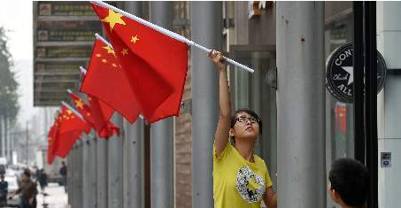
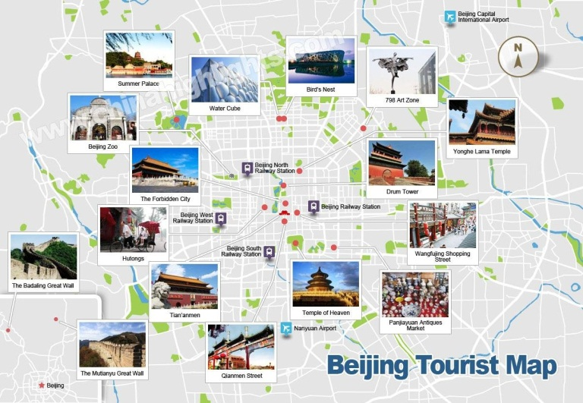
2. sight
❹ [C] 看见的事物；景象；情景：
The practice of hanging flags is a common sight
in many parts of the country on National day.
These mountains are a splendid sight when viewed from the valley floor（谷底）.
❺ [复数] 名胜；景点 = places of interest
Overseas visitors are impressed by the beautiful sights of Beijing.

Slide 9
看见的能力
视力；视觉
看见的行为
看见；瞥见
所见之物
基本义
sight
视域；眼界；视线
看见的范围
看见的事物
景象；情景
看见的名胜古迹
名胜；景点

Slide 10

sight搭配
at first sight
at the sight of
catch sight of
come into sight
lose sight of
out of (one’s) sight
set one’s sights on
进入视线；映入眼帘
看不见；忽略；忘记
一见(就)；乍一看
脱离（某人的）视线
一看见
以……为奋斗目标
看见；发现

Slide 11
Para. 2
Amy
adj.原本的
Our original plan was to see a film at the cinema that afternoon. But in the morning, my friend posted a message on social media saying she had a cold. When I called her, she said she might not be able to make it to the cinema. “Don’t worry,” I said. “Get some rest. We can wait till you get better.”
社交媒体
能够出席；准时到达

Slide 12
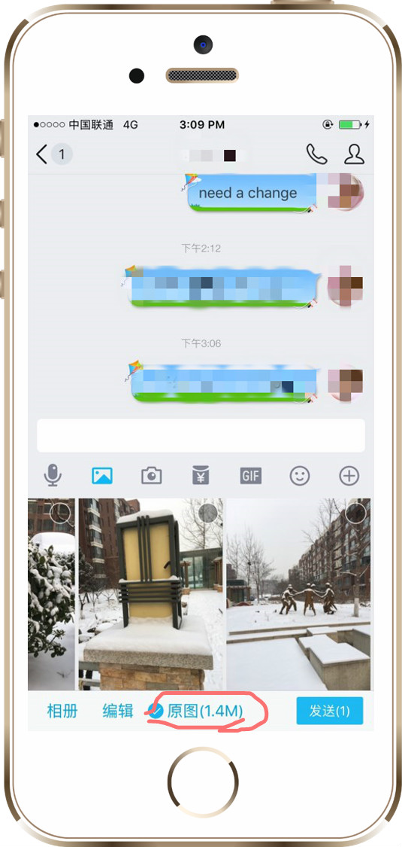
3. original
我们用手机发照片时，会出现“原图”的选项，发原图，清晰度会更高，原图的英语表达是：
original picture
original是“origin — 起源”的形容词

Slide 13

3. original adj. & n.
❶ [只用于名词前] 最初的；原先的：
Our original plan was to see a film at the cinema that afternoon.
❷ [只用于名词前] 原创的；原作的：
In a word, to read the original work is better than to see the film based on it.
❸ 新颖的；创新的；独特的：
That’s not a very original suggestion.
n [C] 原文；原作；原稿：
the book in the original
originality n [U] 独创性；创造力
originally adv.

Slide 14
origin & originate
 origin n
❶ 出身；血统：
Over 80% of the 3.6 million pople are of European origin.
❷ 起源；起因：
This particular custom has its origin in Wales.
 originate v ［正式用语］起源；发源
Mid-Autumn Festival is originated from the moon worship ceremony about 3,000 years ago in Zhou Dynasty.

Slide 15

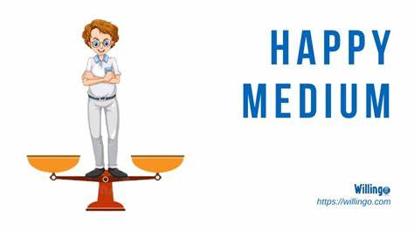
4. medium
① n. 传播信息的媒介，方法
the medium of radio/televison 广播/电视媒介
social media 网络社交媒体
② n.手段，工具
a/the happy medium 皆大欢喜的折中办法
③ adj.中等的，中号的
in the medium term 中期内
of medium height/build 中等身高/身材
He is of medium height, neither too thin nor too fat.
他中等身材，既不太瘦也不太胖。

Slide 16
5. make it
1. As long as you have a dream, keep trying and you’ll make it.
做到；成功
2. The flight leaves in twenty minutes — we’ll never make it.
The next day, she flew with Karen and made it back to George in Virginia within a few days.
(尤指在困难情况下) 准时到达；赶上
3. Shay didn’t make it to another summer and died that winter.
渡过难关
4. I’m sorry I didn’t make it to your party last night.
[口语] 能参加；能出席

Slide 17
Para. 3
Amy
adj. 令人震惊的
Today, however, I received a horrible surprise. A classmate told me she had seen my friend chatting with another girl in a café on Saturday afternoon. How stupid I was! My friend’s “illness” was a complete lie! Instead of recovering at home, she was out having fun with someone else.
vi. 聊天
并非
vi. 恢复健康

Slide 18

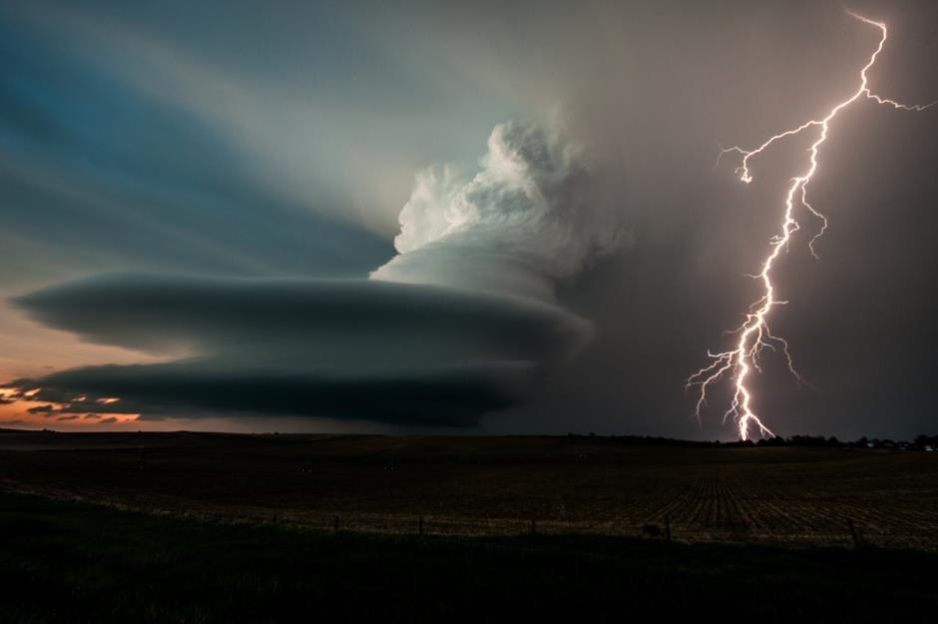
6. horrible
① adj. 令人震惊的
a horrible crime 骇人听闻的罪行
② adj.可恶的，极坏的
horrible weather 糟糕的天气
a horrible man 一个讨厌的人
【词汇积累】
horror n.惊恐，震惊；令人惊恐的事
in horror 惊恐地 to sb's horror令某人恐惧的是

Slide 19
7. recover v.
recover的词源义是“come back, return; regain health; get again”，它的基本义——重新获得 “get again (regain)”
◆ vt（意识、知觉等）恢复
It took her a few minutes to recover consciousness.
❖ vi（从疾病或病态等中）恢复过来
We had a woman patient who was recovering from a knee replacement operation.
⬥ vt 重新获得; 找回
Authorities in New Zealand have decide to recover bodies from White Island after Monday’s volcanic eruption.We worked hard to recover the lost time.
recover from 从...中恢复过来
► recovery n [C] & [U] 痊愈；重获；复苏

Slide 20
Para. 4
Amy
I was so angry that I avoided her during school all day, and I still don’t feel like responding to any of her online messages. The stress of this situation is killing me, and I’m at a loss what to do next.
想要做...
回复
不知所措，困惑

Slide 21

8. loss
After graduating from school, I'm at a loss what to do next.
从学校毕业后，我不知道下一步该做什么。
① n.失去，丧失
weight loss 减重 loss of memory 失去记忆
loss of blood 失血 a sense of loss 失落感
② n.亏损
make a loss 亏损 run/operate at a loss亏本经营
At first, this company was operating at a loss, but it is now making profits.
一开始，这家公司一直在亏本经营，但是现在它已经在盈利了。
at a loss 不知所措，困惑

Slide 22
8. loss
③ n.去世;损失
loss of life 人员伤亡
a big/great loss to... …的巨大损失
We know that the loss of his wife dealt a heavy blow to him.
我们知道妻子的离世对他是一个沉重的打击。
【词汇积累】
lose vi & v. 丢失;失去;输掉
lost adj. 迷路的;丢失的
loser n. 输家;失败者

Slide 23
Cindy
值得做...
I’m so sorry! But this friendship is worth saving: eight years is a long time! Don’t be so quick to judge your friend. Perhaps she knows she’s in the wrong and wants to apologize, or maybe she has a simple explanation for her behaviour. In any case, find an opportunity to have a full and frank talk with her. Listen to what she has to say, and be sure to explain how you feel. I’m sure you can solve this problem together.
vt. 判断
在错误的一方
vi. 道歉，谢罪
无论如何
和...有一次充分、坦诚的谈话

Slide 24
9. judge v. & n.
judgement
n.判断力，看法，判决
Don't judge a book by its cover.
Judging from/by what he said, he was very disappointed.
I judged him to be about 50.
The judge sentenced him to five years in prison.
A panel of judges is now selecting the finalists.
v. 评价，鉴定
v. 判断，断定
v.估计，猜测
n. 法官
n. 裁判员

Slide 25


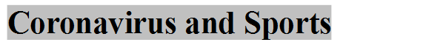
10. apology & apologize
Rudy Gobert is the first NBA player to test positive for coronavirus. He admits being careless, and he has apologized for his behavior.
apologize to sb for (doing) sth

Slide 26
10. apology & apologize
主动道歉/致歉/要求道歉/接受道歉/欠某人一个道歉
offer
make
demand
accept
owe sb
-ize意思为“使成……状态; 使……化”
an apology
名词
apology
summary
standard
动词
apologize
summarize
standardize
形容词
real
special
industrial
动词
realize
specialize
industrialize

Slide 27
11. case
There’s no point complaining now—we’re leaving tomorrow in any case.
无论如何，不管怎样
You’d better take the keys in case I’m out.
以防万一
In case of fire, ring the alarm bell.
如果，假使
In no case may you leave the baby alone at home.
决不(放句首时句子用部分倒装)
Hospital admission is not necessary in most cases.
在大部分情况下
—I’ve made up my mind.
—In that case, there’s no point discussing it.
既然那样

Slide 28
David
I definitely understand how you feel. I also had a friend whom I trusted a lot. When I found out that I was tricked by him, I was really hurt and let go of our friendship. I know you value your friendship and want your friend to value it equally. However, if your friend ignores your feelings or makes you suffer, it’s time to rethink your relationship. Talk to her and decide whether this friendship is still important to you. It’s sad to move on, but you have to accept that friends come and go in life.
vt. 欺骗，欺诈
放弃
vt. 忽视
vi. 受折磨
来来往往；有聚有散

Slide 29


12. trick
tricky adj.狡猾的；棘手的
① vt. 欺骗，欺诈
trick sb. into doing sth.=fool sb. into doing sth.哄骗某人做某事
trick sb. out of sth.=cheat sb. out of sth. 骗走某人的某物
He tricked me into lending him a large sum of money.
他骗我借给他一大笔钱。
He tricked her out of all her savings.
他骗走了她所有的积蓄。
② n.诡计，花招；戏法
play tricks on sb.戏弄某人
hat-trick 三连胜；帽子戏法
trick or treat 不给糖就捣蛋

Slide 30
13. ignore v.
1. to pay no attention to 忽视
He ignored all the “No Smoking” signs and lit up a cigarette.
2. to pretend that you have not seen sb or
that sb is not there 不予理睬
She ignored him and carried on with her work.
ignorant adj. 无知的
be ignorant of sth. 不了解某事
ignorance n. 无知，愚昧

Slide 31
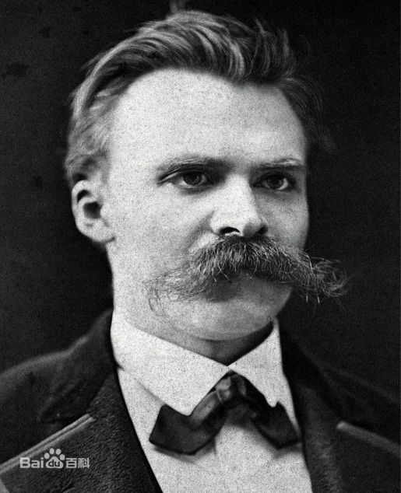
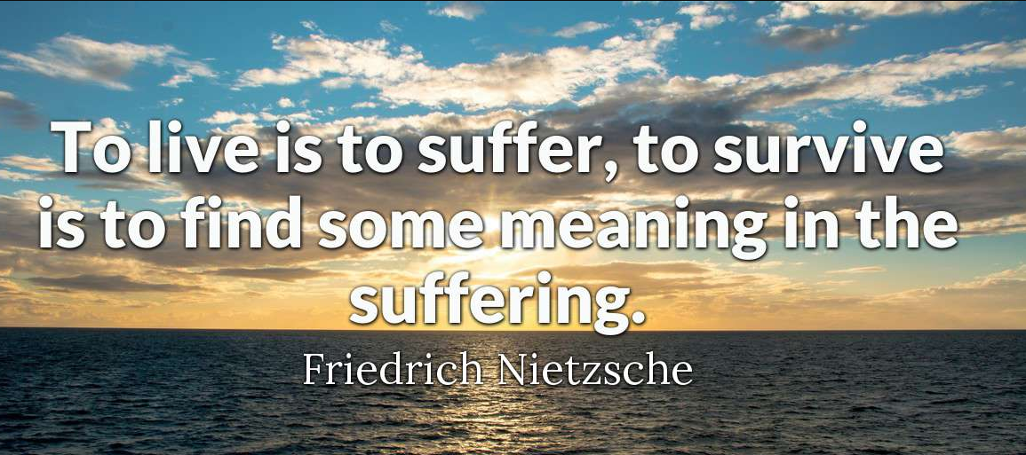
14. suffer
弗里德里希·威廉·尼采(Friedrich Wilhelm Nietzsche, 1844 —1900)，德国哲学家、语言学家、诗人、思想家。他被认为是西方现代哲学的开创者，对于后代哲学的发展有很大影响。
活着就要经受痛苦；而生存是为了在痛苦中寻找意义。
——尼采

Slide 32
14. suffer
◆ vi & vt 患（病）；（因疾病）受苦
suffer (from) a heart attack
He worked in Africa, where many people suffered from blindness for lack of proper treatment.
❖ vi & vt 遭受（困难等）
suffer (from) defeat / loss
You will suffer one day for your carelessness.
⬥ vi 变差；变糟
His school work is suffering because of family problems.
n. suffering [C] 苦难；折磨
[u]（身体或精神上）疼痛；痛苦 physical/mental suffering

Slide 33
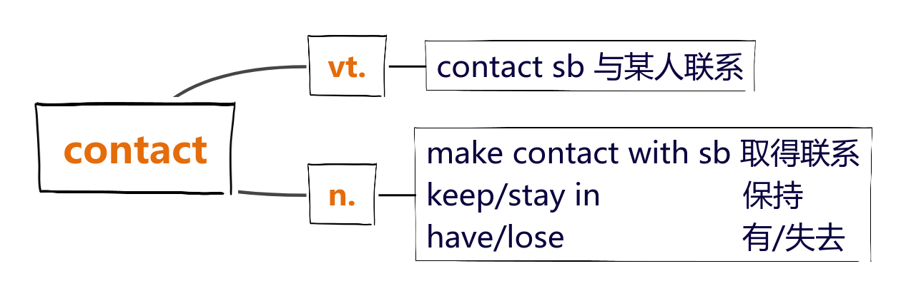
15. contact

Slide 34
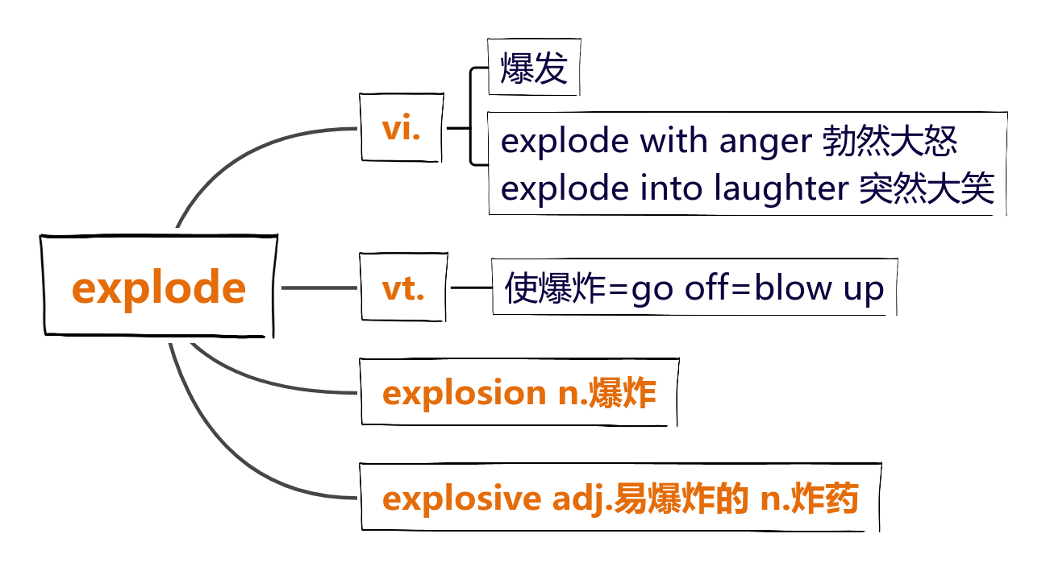
16. explode

